Slide 1
K 23 Application Outline Unrecognized Inpatient Hypercapnic Respiratory Failure
Brian Locke MD
RIP Oct 12, 2023
This research was supported by the National Institutes of Health under Ruth L. Kirschstein National Research Service Award 5T32HL105321 from the NIH,
and The American Thoracic Society Academic Sleep and Pulmonary Integrated Research/Clinical Fellowship (ASPIRE) Program
Notes:
[ ] thoughts – talk to Estelle about IRB hoops; consider sticking to no blood sample (with etco2 as a lower estimate?)
[ ] time of day - need to account for this somehow.
EtCO2 might be a better non-invasive backup? Not great… but just how not-great?
--- could you use info from the Chung study – or reach out to them for corroboration opportunities? Unfortunately, the exact pre-disposition to get blood gasses might be somewhat variable.

Slide 2
NIH Grants 101
Programming training grants (T32*): Granted to programs (PI Paine)
Individual fellowship grants (F31-3): (individual, pre- and postdoc)
Career development grants (K08 and K23): 30% success
Established investigator grants (R01..): 10% success
Funding deadlines for (new) K-awards: Mid Feb, Mid June, Mid Oct

Slide 3
Career Development (K) Award Criteria:
NIH goal: support early-career investigators to allow them to become independent investigators competitive for major grant support.
Criteria:
Candidate (not discussing today)
Team: Mentors/Co-mentors/Consultants/Collaborators
Research Plan
Career development plan, career goals, and objectives.
Environment + Institutional Commitment to the Candidate (not discussed today)

Slide 4
SPECIFIC AIMS

Slide 5
Overview:
Hypercapnic Respiratory Failure is associated with high readmission rates, symptom burden, and mortality risk.
Hypercapnic respiratory failure results from many contemporary health threats: obesity, opiate use, advanced lung disease, and multimorbidity.
Diagnosis of Hypercapnic respiratory failure requires a painful and infrequently obtained diagnostic test (ABG).
Limited evidence suggests clinicians frequently fail to identify patients with hypercapnia, even in the inpatient setting (a particularly high-risk group after discharge)
This is a problem for both clinical care and research
Notes:
’Specific Aims'

Slide 6
OVERALL: There is a significant burden of unrecognized hypercapnia among hospitalized patients. | OVERALL: There is a significant burden of unrecognized hypercapnia among hospitalized patients. 3 aims
 | Aim 1: How to find them? | Aim 2: How many are out there? | Aim 3: Might it matter?
Hypothesis | Less invasive methods of blood CO2 assessment (TcCO2, VBG, Risk Stratification) can identify hypercapnia with sufficient accuracy to estimate prevalence. | There is a sizable prevalence of unrecognized hypercapnia among hospitalized patients. | Inpatients who were predicted, but not identified, to have hypercapnic respiratory failure based on data elements from the health record, are at high risk of readmission.
Barrier | TcCO2, VBG, and bicarbonate are perceived as problematic for individual patient use. | ABGs a selectively and unreliably obtained in clinical practice, and cannot be indiscriminately obtained for research | Prior work showing high readmission rates only assess patients who have been identified as hypercapnic.
Insight | Scatter, without bias, can still allow estimation of prevalence | Risk modeling allows for stratified sampling = better efficiency. | ABG PaCO2 is an imperfect reference standard
Approach | Obtain paired ‘samples’ with ordered ABGs (inpatient). | Non-invasively sample (with TcCO2, or VBG) patients predicted to have a certain strata of risk. | Among patients with an admission for hypercapnia that is identified, how many had preceding admissions likely to have hypercapnia?

Slide 7
Why is this worth establishing?
Owing to the conditions the lead to hypercapnic respiratory failure, the prevalence is almost certainly increasing.
Limited and indirect evidence suggests we do a poor job identifying these patients
Many patients are first identified at a decompensation event
Effective therapy Exists
Research tools to establish the burden of disease (prevalence, attributable risks) have not yet been developed.
Doing so will enable several lines of research: diagnostic pathway benchmarking, population health, diagnosis->management benchmarking
Notes:
Prior research has focused on management of individual diseases (COPD, OHS, NMD), but less attention has been paid to diagnosis,
The research paradigm of evaluating individual causes has been minimally helpful for diagnosis

Slide 8
RESEARCH APPROACH

Slide 9

Importance of the Problem
2022: Liverpool AUS, 1 regional hospital services the entire district
Identified by initial ABG (w/n 24h) PaCO2 over 45, excluded iatrogenic causes/sedation. N=891 people
Normalized rates of hypercapnia to population demographics
150 per 100,000 person/year
Acidosis in 55%.
Comparison: GBD estimate of Decompensated Cirrhosis: 132 per 100,000 person/year
Limitation: ABG required
Admitted to hospital (Floor or ICU) with ABG showing PaCO2 over 45 mmHg and pH 7.35-7.45
Notes:
https://www.thelancet.com/journals/langas/article/PIIS2468-1253(19)30349-8/fulltext cirrhosis citation

Slide 10
Expected Contribution / Innovation
Arterial blood gas sampling is currently required to to diagnose hypercapnic respiratory failure.
To be included in a study, you must* be diagnosed
Some approaches, like VBG, are currently widely used but not validated.
ABGs are painful, only give a snapshot, and must be actively considered by the clinician
Thus, alternative methods of identifying patients may improve the patient experience, the reliability of diagnostic modalities, and the representativeness of research.
Innovation: utilizing risk modeling (Bayes theorem) derived from big data, we can more efficiently sample and better estimate population prevalence.

Slide 11
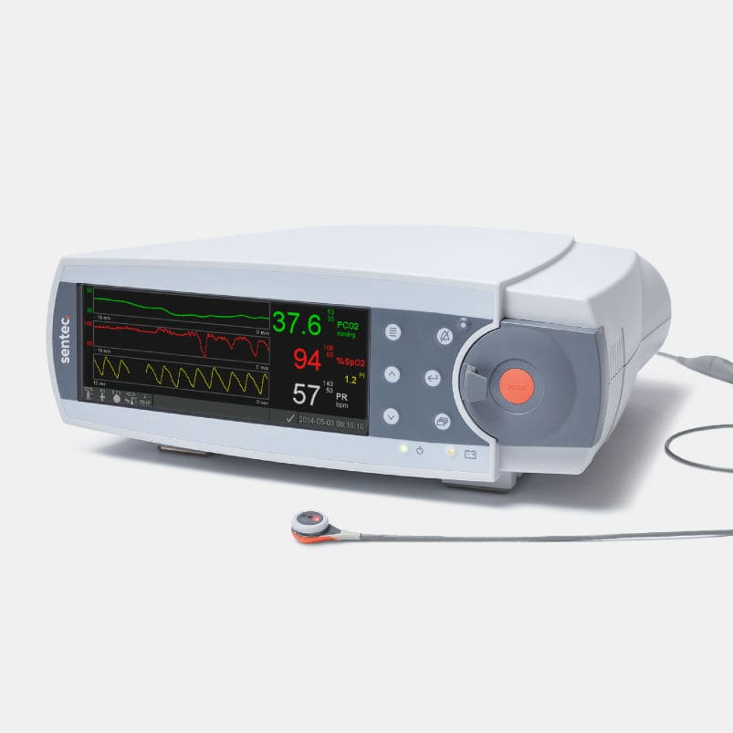
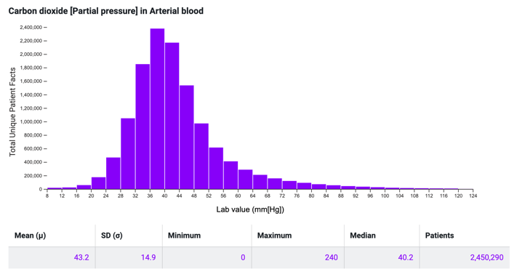

Aim 1: Local Validation of Less-Invasive Hypercapnia Verification
TcCO2 Sentec: Validated for use NMD follow-up, PICU
95% Agreement with PaCO2: +/- 6 mmHg, Bias +0.1 mmHg
Conway et al. Thorax 2019. SRMA 44 Studies (n=1786)
50: Correct 97%, Wrong 3%: weight: 1.81%
49: Correct 93%, Wrong 7%: weight: 1.98%
48: Correct 88%, Wrong 12%: weight: 2.39%
47: Correct 80%, Wrong 20%: weight: 2.47%
46: Correct 69%, Wrong 31%: weight: 2.92%
45: Correct 57%, Wrong 43%: weight: 3.11%
SENSITIVITY
SPECIFICITY
44: Correct 57%, Wrong 43% 3.56%
43: Correct 69%, Wrong 31% weight 3.73
42: Correct 80%, Wrong 20% weight 4.16%
41: Correct 88%, Wrong 12% weight 4.25%
40: Correct 93%, Wrong 7% weight 4.58%
39: Correct 97%, Wrong 3%: weight 4.59%
TriNetX Research Network
All ABGs obtained at 70 health systems (n=10 million)
Expected distribution of PaCO2 among people who get ABG
Expected: Se: 89%, Sp: 92%

Slide 12
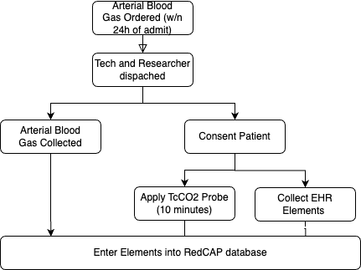
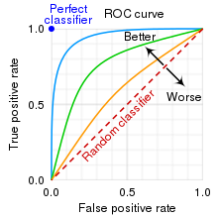
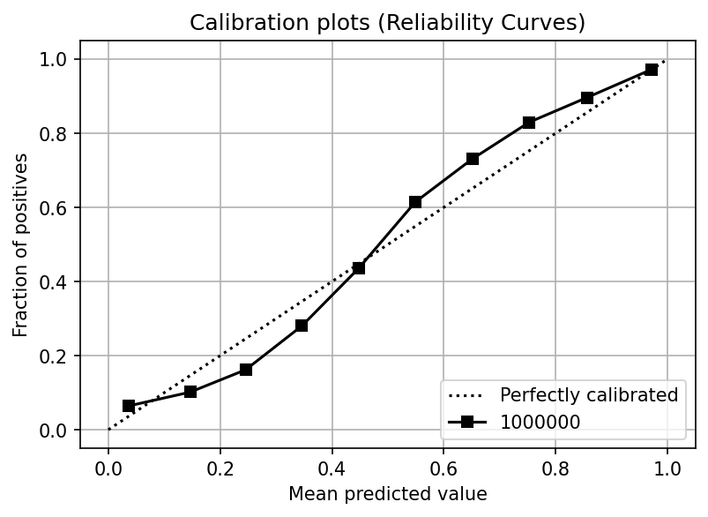
Aim 1: Local Validation of Less-Invasive Hypercapnia Verification
Design: Paired, within-subjects samples
Outcomes:
ABG-TcCO2
Bland Altman Analysis (Bias, Agreement)
Sensitivity, Specificity
Prediction modeling:
Discrimination (correctly order risk? AUC)
Calibration (if 25% chance CO2>45, is it really 25%?)
Sample Size: n=65 -> 0.8 power for limits of agreement (edge of 95CI) ~8
Notes:
loasampsi 0.1 8, sd(3) level(95) power(0.8)

Slide 13
Aim 1: Local Validation of Less-Invasive Hypercapnia Verification
Why validate locally? (there are already 44! studies)
Agreement (with ABG) dependent on technique in Conway SRMA
Allows feasibility testing (consenting), external validation, & performance benchmarking (calibration?) of EHR-based risk stratification.
How will this fail?
Enrollment time-pressure, batched in early AM
Low patient (surrogate) ability to consent
Retroactive consent?
TcCO2 doesn’t work well
Methodology audit
VBG assessment*
Predictive modeling doesn’t work well*

Slide 14
Aim 2: How much unrecognized hypercapnia is out there?
Missing data: if everyone had an ABG, you could just count.
Insight: If you can predict a.) who gets an ABG b.) who will have hypercapnic given they get an ABG => who has hypercapnia
Must use data elements that are commonly present
Can this be done?
All TriNetX encounters (ambulatory, emergency, inpatient) for which a reasonable clinician would consider hypercapnic respiratory failure:
Dx code resp failure, predisposing condition, ABG/VBG checked, BMI>40

Slide 15
Aim 2: How much unrecognized hypercapnia is out there?
 | Total | No ABG Obtained | ABG Obtained
 | N=879,019 | N=675,620 | N=203,399
Ambulatory | 39% (343,699) | 50% (334,457) | 5% (9,242)
Emergency | 20% (175,792) | 22% (146,066) | 15% (29,726)
Inpatient | 41% (359,528) | 29% (195,097) | 81% (164,431)
Jan-Dec 2022:
32% (64,500) showing PaCO2 > 45 mmHg
Flipped optimal use from previously validated use (OHS)
Spectrum effect: more ways for FN
What factors influence performance?
Note: ‘compensation status’ is self-referential.
Remember: ‘Boston Rules’ are a model…

Slide 16
Aim 2: How much unrecognized hypercapnia is out there?
What factors are independently associated with better discrimination?
Threshold independent
AUC: “if you choose a random patient with Hypercapnia, what is the chance they will have a higher a higher HCO3- than someone without”
???

Slide 17
Aside: What threshold should you use?
Statistics alone cannot tell you
You need to weight the relative importance of false positives vs. false negatives
There is no data to guide the trade-off
HCO3- Threshold | Ambulatory |  | Emergency |  | Inpatient |  | Critical Care
 | Se | Sp | Se | Sp | Se | Sp | Se | Sp
≥24 mEq/L | 86.3 | 47.6 | 82.6 | 47.1 | 73.4 | 60.4 | 65.0 | 67.5
≥25 mEq/L | 78.8 | 61.3 | 77.0 | 58.6 | 65.4 | 71.2 | 57.1 | 76.9
≥26 mEq/L | 70.0 | 74.3 | 69.4 | 70.2 | 56.7 | 80.6 | 49.2 | 84.6
≥27 mEq/L | 60.5 | 84.5 | 60.8 | 79.0 | 48.2 | 87.4 | 41.8 | 89.9
≥28 mEq/L | 50.7 | 91.5 | 52.3 | 86.6 | 40.4 | 92.1 | 35.0 | 93.6
≥29 mEq/L | 40.4 | 95.8 | 43.8 | 91.6 | 34.0 | 95.2 | 29.5 | 96.0
≥30 mEq/L | 31.9 | 97.9 | 35.8 | 95.1 | 28.5 | 97.1 | 24.9 | 97.4

Slide 18
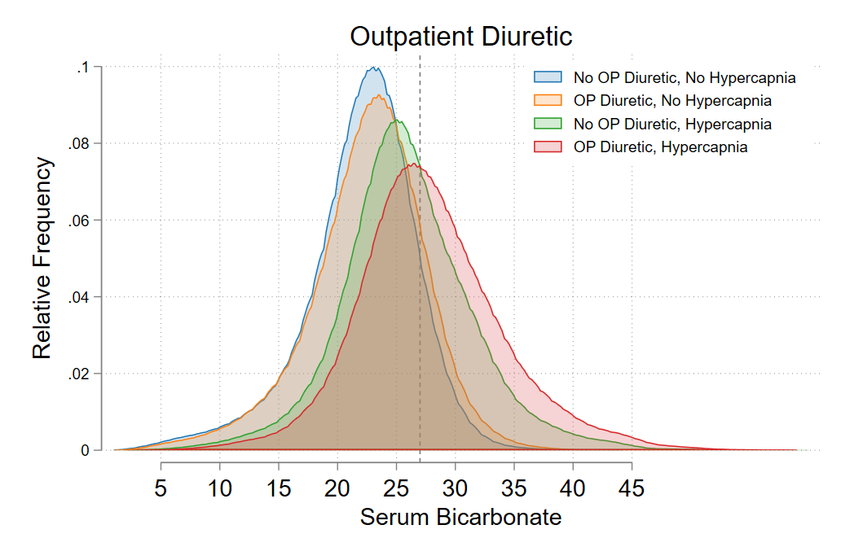
Aim 2: How much unrecognized hypercapnia is out there?
Empirically, HCO3- discriminates better between CO2>45 and not when patients are on loop diuretics.
This mirrors theories about pathogenesis of OHS
And suggests diuretics cause some OHS
We are bad at reasoning from physiology
No Hypercapnia:
Loop HCO3 (orange)
> No loop HCO3 (blue)
W/ Hypercapnia:
Loop HCO3 (red)
>> No loop HCO3 (green)

Slide 19
Aim 2: How much unrecognized hypercapnia is out there?
Can you add more elements?
Location of care
HCO3
K
…..

Slide 20
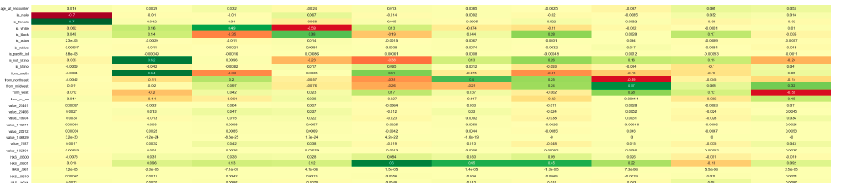
Aim 2: How much unrecognized hypercapnia is out there?
What other elements
PCA
Age
Location
Sex
Outpatient COPD med
Lactate
Etc.
LASSO

Slide 21
Aim 2: How much unrecognized hypercapnia is out there?
Nowbar et al. 2004: All BMI ≥35 kg/m² admitted to inpatient medicine service at the Denver VA. Everyone (n=277) gets an ABG. 31% had hypercapnia. Only 1/3 of those had therapy started (teams were told)
Only study I am aware of that did not rely on clinician gestalt to obtain ABG
Old, how much iatrogenic?, unique population.
Other, indirect estimates?
Marik et al 2013, Journal of Intensive Care Medicine: patients with malignant OHS ”…had been admitted to our hospital on average 6 times over the previous 2 years; 75% had been erroneously diagnosed and treated for chronic obstructive pulmonary disease (COPD)/asthma and 86% had been treated with diuretics for congestive cardiac failure”
Outside of obesity?
Notes:
Nowbar S, Burkart KM, Gonzales R, Fedorowicz A, Gozansky WS, Gaudio JC, Taylor MR, Zwillich CW. Obesity-associated hypoventilation in hospitalized patients: prevalence, effects, and outcome. Am J Med 2004;116:1–7.

Slide 22
Aim 2: How much unrecognized hypercapnia is out there?
Design:
Within 24 hours from admit
Stratified sampling by decile of predicted likelihood of hypercapnia
Overall prevalence estimate = weighted [by overall hospital] average of decile prevalences.
Stratified sampling improves efficiency
Apply TcCO2
Sample Size Calculation:
Complex but doable
Upper bound = unstratified: n=200 would give 5% 95CI width at expected prevalence of 2.5%
Notes:
Nowbar S, Burkart KM, Gonzales R, Fedorowicz A, Gozansky WS, Gaudio JC, Taylor MR, Zwillich CW. Obesity-associated hypoventilation in hospitalized patients: prevalence, effects, and outcome. Am J Med 2004;116:1–7.

Slide 23
Aim 2: How much unrecognized hypercapnia is out there?
Outcomes:
Estimated in-hospital prevalence
% recognized(?) – should information be shared with teams?
(or, vs historical control)
How will this fail?
Several pieces of data will update power calc (distribution of predicted hypercapnia deciles, bias/agreement of TcCO2)
Can I access EHR data fast enough?
Hawthorne effect?
What if TcCO2 isn’t good enough? (VBG?)
Elevation adjustment? Due to hypoxemia, do they get identified earlier?

Slide 24
Aim 3: Might it matter?
Current reference standard? Is PaCO2 above 45 mmHg (classification)
Alternative (better) reference standard for ventilatory failure?
Predicting future risk of insufficient ventilation
Predicting differential treatment response (will they get better I I help their ventilation?)
If you expand the type of patients diagnosed, do you dilute the importance of the finding?
Everyone (probably) gets identified if their hypercapnia is severe enough
Analogous to Cancer Screening*: Lead time bias? Will Rogers Phenomenon?
Notes:
Though I’m not necessarily

Slide 25
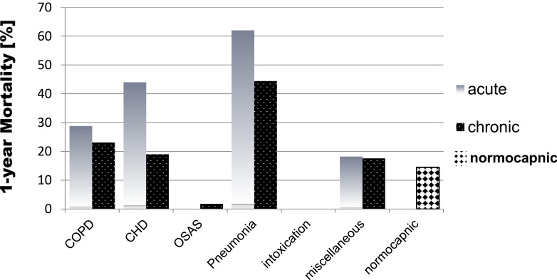
Aim 3: Might it matter?
Rigor of the supporting research:
Marik et al. 2013: patient diagnosed with OHS are repeatedly admitted and missed diagnosed prior to their ultimate recognition
*Single center with non-representative enrollment (only obese patients)
Meservey et al 2020. and Vonderbank et al 2021: readmission rates are high after diagnosis (~1/3 of patients) - likely because the pipeline from identification to treatment is very unreliable.
*This only studies patients who are identified as hypercapnic
Cavalot et al 2022: across etiologies (enrolled in an emergency department), patients with hypercapnia (by ABG) have worse outcomes than patients without
*Not matched for other prognostic indicators

Slide 26
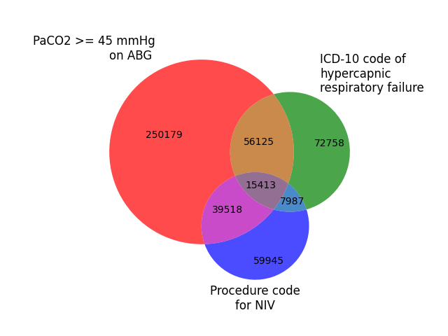
Aim 3: Might it matter?
Study Design:
Retrospective EHR-based review
Dataset: Longitudinal, ideal self-contained system
Exposures of interest:
Hypercapnic Respiratory Failure by ICD code
Hypercapnic Respiratory Failure by ABG (or by VBG) & not ICD code
Predicted Risk of Hypercapnic Respiratory Failure by commonly obtained data-elements
Effect modifier: PAP/NIV therapy
Outcome: Hazard of death or rehospitalization with hypercapnia
Expected finding:
ICD code (untreated) > ICD code (treated) ?= Blood gas confirmed > Highly Likely to have hypercapnia

Slide 27
Aim 3: Might it matter?
Why might this fail?
ABG often not present in datasets reliably
Data cleaning by center?
May be too hard to determine who gets (outpatient) treatment
Easier Alternative: among patients admitted with recognized hypercapnia, how many preceding admissions were likely to have had hypercapnia by risk modeling?
Anticipated effect (for power) might be updated by Aim 2

Slide 28
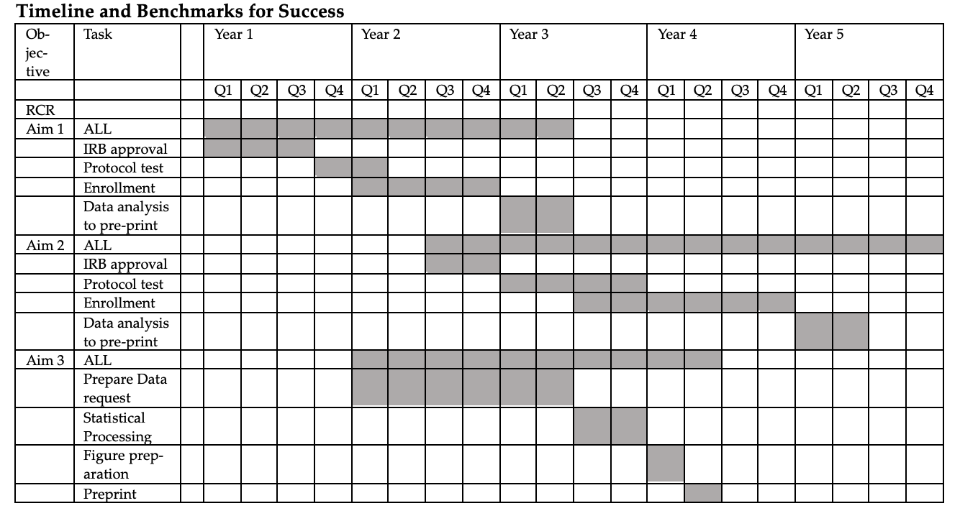

Slide 29

Why do this in UT?
[In 1960]… The most prominent of these was based out of the University of Utah and the Latter-day Saints (LDS) Hospital in Salt Lake City. There, Homer Warner, together with his col. leagues Allan Pryor and Reed Gardner, began building what would arguably become the most successful health information infrastructure in the country …Warner and his colleagues grew interested in the possibility of applying ideas about Bayes's theorem and conditional probabilities to actual clinical data. They quickly settled on congenital heart disease as their test domain.
…
The team thus assembled a database: a matrix that included incidence information on about fifty-seven symptoms and thirty-five diseases. Warner translated this mathematical approach for implementation on a digital electronic computer. ….
…
The group found that, in a sample of seventy-four patients with congenital heart disease, the diagnostic performance of the computer was on par with that of physicians who had seen the same patients. The results grabbed national attention. "Computer Is Found Useful in Heart Disease," the New York Times reported.
…
The findings also put wind in the sails of Warner's larger research enterprise at Utah. Before long, Warner's narrow focus on cardiac diagnosis broadened. The project that started in the Cardiovascular Laboratory soon spread outward, evolving into a larger health information system called Health Evaluation through Logical Processing (HELP). By the late 1960s, HELP had been adopted widely across the LDS Hospital
We’re the only group (that I’m aware of) doing statistical modeling that will enable to do this efficiently
We have institutional experience with TcCO2 [Jeanette, PICU]
Resources and track-record of successful bioinformatics application….

Slide 30
Future Directions
What studies would this set the stage for?
Construct more representative cohort of inpatients with hypercapnia:
What comorbidities do they have? What is their prognosis?
Allow surveillance of rates of hypercapnia
Does it change with air quality? (e.g. U of U / IMC admission by air quality
Is it increasing overall?
Does more aggressive case-finding improve outcomes? [randomize to BPA of hypercapnia-alert?]

Slide 31
OVERALL: There is a significant burden of unrecognized hypercapnia among hospitalized patients. | OVERALL: There is a significant burden of unrecognized hypercapnia among hospitalized patients. 3 aims
 | Aim 1: How to find them? | Aim 2: How many are out there? | Aim 3: Might it matter?
Hypothesis | Less invasive methods of blood CO2 assessment (TcCO2, VBG, Risk Stratification) can identify hypercapnia with sufficient accuracy to estimate prevalence. | There is a sizable prevalence of unrecognized hypercapnia among hospitalized patients. | Inpatients who were predicted, but not identified, to have hypercapnic respiratory failure based on data elements from the health record, are at high risk of readmission.
Barrier | TcCO2, VBG, and bicarbonate are perceived as problematic for individual patient use. | ABGs a selectively and unreliably obtained in clinical practice, and cannot be indiscriminately obtained for research | Prior work showing high readmission rates only assess patients who have been identified as hypercapnic.
Insight | Scatter, without bias, can still allow estimation of prevalence | Risk modeling allows for stratified sampling = better efficiency. | ABG PaCO2 is an imperfect reference standard
Approach | Obtain paired ‘samples’ with ordered ABGs (inpatient). | Non-invasively sample (with TcCO2, or VBG) patients predicted to have a certain strata of risk. | Among patients with an admission for hypercapnia that is identified, how many had preceding admissions likely to have hypercapnia?

Slide 32
Career Development Plan
Mentored | Didactic | Experiences | ‘Academic Stewardship’
 | MDCRC6270 – Applied Modern Causal Inference PHS7035 – Theory of Modern Causal Inference PHS7045 – Advanced Programming in R and the CHPC MDCRC6375 - Advanced Methods in Dissemination and Implementation Science | SCCM Datathon (MIMIC-IV etc.) U of U DELPHI / Data Carpentry workshops | ASPIRE Webinars Society Committees(?)

Slide 33



Upcoming talks
Oct 20
Capstone Presentation, December 6th

Slide 34
Background:
Health-record data elements | Transcutaneous CO2 Monitoring | Venous Blood Gas
Commonly obtained clinical features markedly change the pre-test probability of hypercapnia. | Allows non-invasive/painless assessment, though not clinically used. | Frequently obtained in Emergency Departments and used to suggest, though often not definitively diagnose, hypercapnia
 | 95% Agreement with ABG: +/- 6 mmHg Bias ~0.1 mmHg | Systematically biased toward elevated PaCO2, amount may be somewhat predictable from physiology.
Performance not previously validated in most causes of hypercapnic respiratory failure. | Accuracy is believed to be insufficient for clinical use in individual | May be inaccurate in patients with the highest need for accurate diagnosis (e.g. poor perfusion)
Notes:
Maybe actually separate out this

